Slide 1
Professional Practices
Intellectual Property

Slide 2
Intellectual Property
Introduction
Confidential Information
Patents
Copyright
Acts permitted in relation to copyright
Remedies for breach of Copyright
Plagiarism
Trade Secrets
Open Source Software
Shareware VS Freeware

Slide 3
What is Intellectual Property?
Intellectual property (IP) refers to creations of the mind such as:
inventions;
literary and artistic works;
designs; and
symbols, names and images used in commerce
IP is protected in law by, for example, patents, copyright and trademarks.
It enable people to earn recognition or financial benefit from what they invent or create
IP system aims to foster an environment in which creativity and innovation can flourish

Slide 4
What are intellectual property rights?
Rights which allow creators, or owners, of patents, trademarks or copyrighted works to benefit from their own work or investment in a creation.
These rights are outlined in Article 27 of the Universal Declaration of Human Rights.
Provides for the right to benefit from the protection of moral and material interests resulting from authorship of scientific, literary or artistic productions.

Slide 5
IP was first recognized in the Paris Convention for the Protection of Industrial Property (1883) and the Berne Convention for the Protection of Literary and Artistic Works (1886)
Both agreements are administered by the World
Intellectual Property Organization (WIPO)

Slide 6
Types of Intellectual Property
Industrial designs
Patents
Copyright
Trademarks
Geographical indications

Slide 7
Intellectual property rights are often the most valuable assets owned, used and developed by a software house.
Intellectual property rights include:
Confidential information
Patents
trade marks
Designs
Copyrights protecting computer programs

Slide 8
Confidential Information
Information “which is not public property and public knowledge”
Any category of information, from personal confidences, to trade secrets and sensitive government information, any or all of which a computer scientist might handle in the course of his or her work, or all or any of which a firm may want to protect against unauthorized use or disclosure by others
Information will be protected only if it is confidential. Non-confidential information, unless protected, e.g. by copyright or a patent is deemed to be in the public domain and can be used by anyone.

Slide 9
Confidential Information
Three conditions must be satisfied before an action for breach of confidence can succeed:
The information must be confidential
The information must have been disclosed in circumstances which give rise to an obligation of confidence
There must be an actual or anticipated unauthorized use or disclosure of the information

Slide 10
Patents
A government authority conferring a right or title for a set period, especially the sole right to exclude others from making, using, or selling an invention
A patent gives to an inventor a monopoly in an invention. This means that the inventor is given the exclusive right to use or exploit the invention for a defined period

Slide 11
Patents
Patent Act merely sets out a number of criteria which must be satisfied before an invention can be patented
A patent may only be granted if:
The invention is new
It involves an inventive step
It is capable of industrial application
The subject matter of the invention does not fall within an excluded class

Slide 12
Patents
It is possible to patent something which is more than just a program—something which can be called, for simplicity, a “program plus”
A computer program is not excluded from patentability if it produced, or is capable of producing, a further technical effect beyond the normal physical interaction between software and hardware, i.e. it is potentially patentable if it makes something else do something.

Slide 13
Copyright
The exclusive legal right, given to an originator or an assignee to print, publish, perform material, and to authorize others to do the same
Copyright protects more items generated by businesses or by individuals than any other aspect of intellectual property law
It can protect business letters, manuals, diagrams, computer programs
Copyright owners face the specter of unlimited piracy through uncontrolled copying with the advent of internet

Slide 14
Copyright
What we will probably see over the next few years are stronger laws, more rights for copyright owners, widespread licensing schemes and greater use of technical anti-piracy or copy-monitoring devices and electronic rights management systems
Copyright law gives six exclusive rights to the owner of copyright:
Copy the work
Issue copies to the public
Rent or lend the work to the public
Perform, play or show the work in public
Broadcast the work or include it in a cable programmed service
Make an adaptation of the work or to do any of the above with an adaptation
The rights apply equally to published and to unpublished works

Slide 15
Acts permitted in relation to copyright
Some acts are permitted under the 1988 Act, even though they would otherwise amount to breach of copyright.
Fair dealing
Making back-up copies of computer programs
Transfers of works in electronic form
De-compilation for the purpose of interoperability
Error correction
Databases

Slide 16
Remedies for breach of copyright
A copyright owner has all the usual civil remedies of search, injunction, damages and an action for an account of profits made in breach of copyright
If it is shown that at the time of the infringement of copyright the defendant did not know and had no reason to believe that copyright subsisted in the work, then the plaintiff is not entitled to damages against the defendant

Slide 17
Remedies for breach of copyright
A copyright owner is also given an important power to enter premises without using force in order to seize infringing copies, or articles specifically designed or adapted for making copies

Slide 18
Plagiarism
the practice of taking someone else's work or ideas and passing them off as one's own.
All of the following are considered plagiarism:
Turning in someone else's work as your own
Copying words or ideas from someone else without giving credit
Failing to put a quotation in quotation marks
Giving incorrect information about the source of a quotation
Changing words but copying the sentence structure of a source without giving credit
For a computer program changing variable names only, or not changing the structure or flow of a program

Slide 19
Trade Secret
What is a Trade Secret?
A trade secret is a formula, pattern, physical device, idea, process, or compilation of information which is not generally known or reasonably ascertainable, by which a business can obtain an economic advantage over competitors or customers.

Slide 20
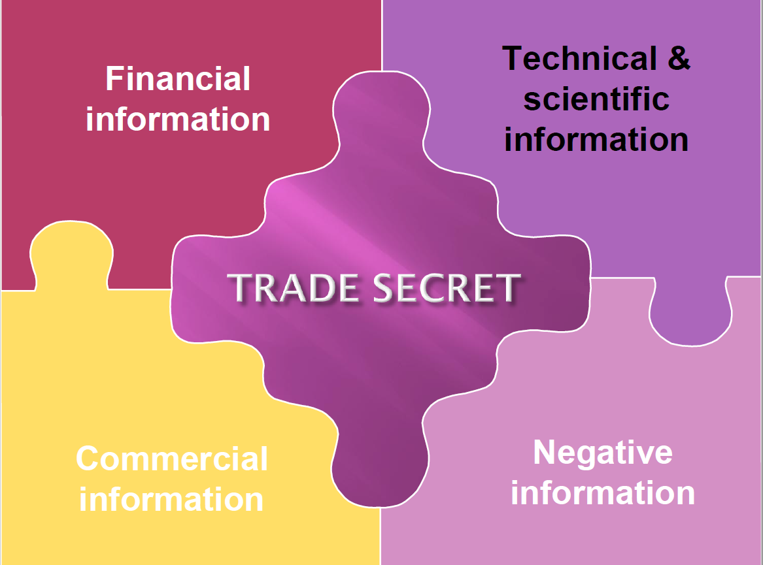
Trade Secrets

Slide 21
Example of Potential Trade Secrets
A formula for a sports drink
Survey methods used by professional pollsters, and Recipes (food)
A new invention for which a patent application has not yet been filed
Marketing strategies
Manufacturing techniques
Computer algorithms

Slide 22
What is required to maintain the Trade Secret Secrecy

Slide 23
Ways to Protect the Trade Secrets
Restrict access to the information (lock it away in a secure place, such as a bank vault)
Limit the number of people who know the information
Have the people who know the trade secret agree in writing not to disclose the information (sign non-disclosure agreements)
Have anyone that comes in contact with the trade secret, directly or indirectly, sign non-disclosure agreements
Mark any written material pertaining to the trade secret as proprietary

Slide 24
Advantage of Trade Secret Protection
Unlimited duration -trade secrets could potentially last longer than patents (20 years) and copyrights
Your protection is theoretically worldwide.
No application required
No registration costs
No public disclosure or registration with government agency
Effective immediately

Slide 25

Open Source Software
Open-source software (OSS) is computer software that is available in source code form: the source code and certain other rights normally reserved for copyright holders are provided under a software license that permits users to study, change, improve and at times also to distribute the software.

Slide 26
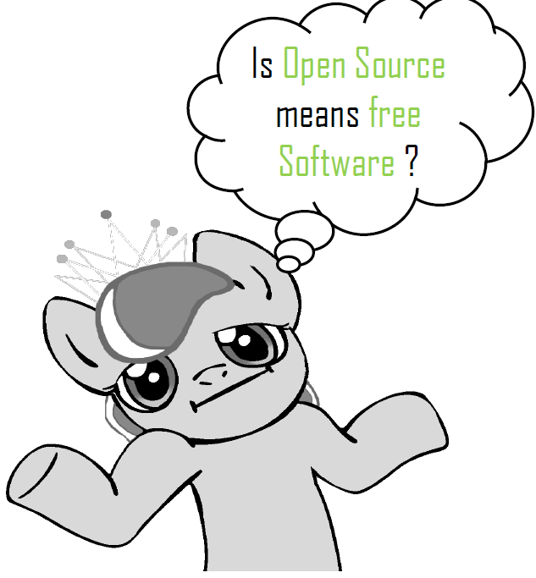
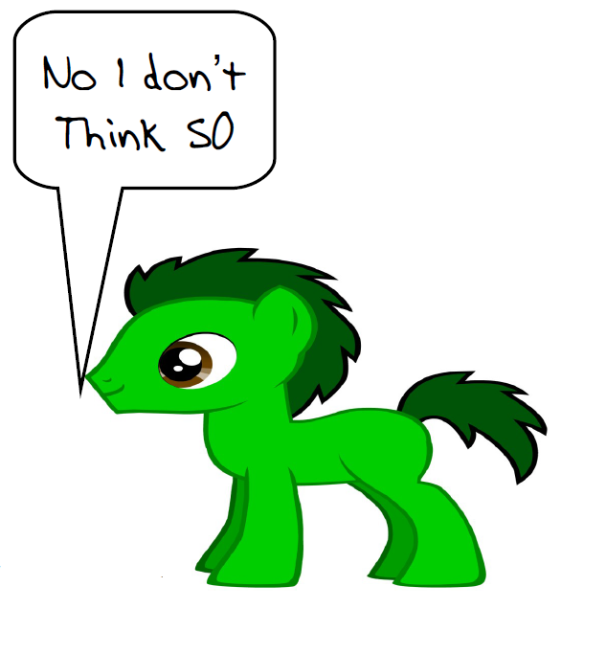
Open Source Software

Slide 27
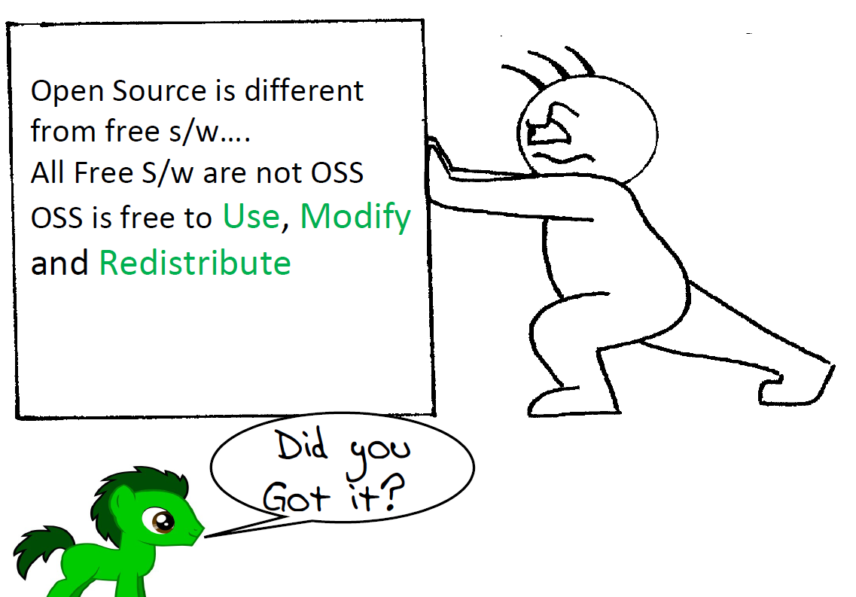
Open Source Software

Slide 28
Benefits of Open Source Software
Security
Quality
Customizability
Freedom
Flexibility
Interoperability
Audit ability
Support Options
Cost
Try Before You Buy

Slide 29
Freeware vs. Shareware
Freeware software is a software that is available free of cost. An user can download freeware from internet and uses it. These softwares do not provide any freedom of modifying, sharing and studying the program as in open source software. Freeware is closed source.
Users prefer freeware because of following reasons –
Available free of cost
Can be distributed free of cost
Some examples of freeware software are –
Adobe PDF
yahoo messenger
Google Talk
MSN messenger

Slide 30
Freeware vs. Shareware
Shareware software is a software that are freely distributed to users on trial basis. There is a time limit inbuilt in the software( for example- free for 30 days or 2 months). As the time limit gets over, it will be deactivated. To use it after time limit, you have to pay for the software.
Users prefer shareware because of following reasons –
Available free of cost
helps to know about the product before buying it
Some examples of freeware software are –
Adobe acrobat 8 professional
PHP Debugger 2.1.3.3
Winzip

Slide 31
Reading Material
https://www.nap.edu/read/5758/chapter/6#46
https://scholarsbank.uoregon.edu/xmlui/bitstream/handle/1794/12593/Yahong.pdf?sequence=1&isAllowed=y
https://www.lgmadvisors.com.au/intellectual-property-case-studies/
Thank you!

